Slide 1
Agile Methodology

Slide 2
What is agile development?
Resistant to over-planning (anti bike-shedding)
Undocumented code that works is better than documented code that doesn’t
Ongoing collaboration and communication with stakeholders is essential
Agile vs. Waterfall

Slide 3

The Manifesto for
Agile Software Development
Although these ideas are not new, this list of 12 principles (laid out at a conference in Utah in February of 2001) codified them – and completely changed the game.

Slide 4
Test-Driven Development
1
User Stories & Acceptance Criteria

Slide 5
Business people and developers must work together daily throughout the project.

Slide 6
Test early, and test often
As a product owner,
I want to be involved with the process,
So that the end result doesn’t stink.
The Product Owner acts as the voice of the customer, and is responsible for making sure the software delivers value.

Slide 7
Iteration Planning Meeting
2
A Man, A Plan, A Canal: Panama

Slide 8
The best architectures, requirements, and designs emerge from self-organizing teams.

Slide 9
Let’s talk about points
Fibonacci sequence: 1, 2, 3, 5, 8 …
An imprecise, intuitive measure
Complexity and uncertainty
It’s not about time

Slide 10
Pair Programming
3
How good is it, really?

Slide 11
Continuous attention to technical excellence and good design enhances agility.

Slide 12
2 heads are better than 1
Studies show pairing actually saves money by reducing bugs
Pairing also helps prevent domain knowledge from becoming siloed
Teaching and knowledge transfer is a natural byproduct of pairing

Slide 13
The
Software Sprint
4
Gotta Go Fast

Slide 14
Deliver working software frequently, from a couple of weeks to a couple of months, with a preference to the shorter timescale.

Slide 15
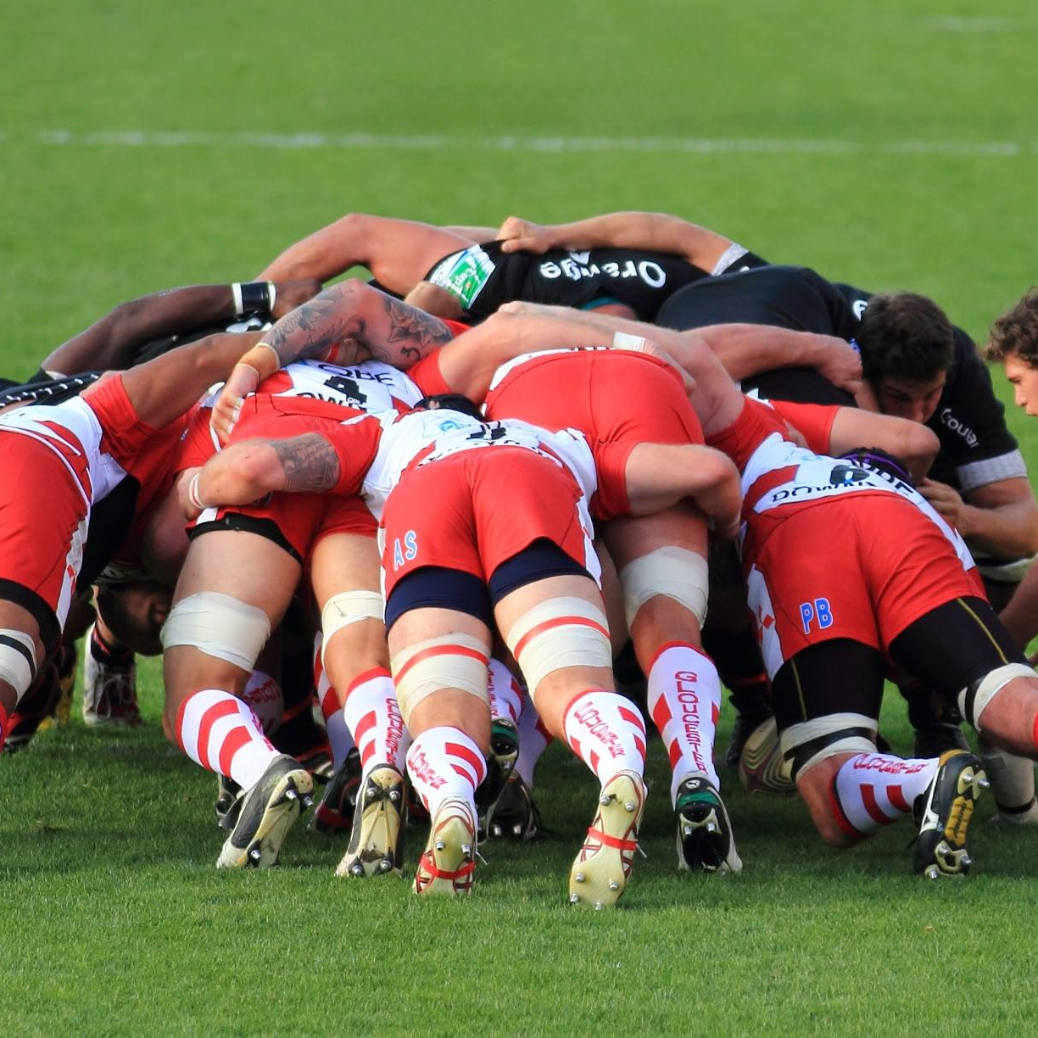
This is a scrum
A timeboxed face-to-face meeting, every day, at the same time and in the same place. Scrum starts on time (even if not everyone is there) and is not a place for detailed discussions.

Slide 16
Retrospective
5
What Kind of Day Has It Been

Slide 17
At regular intervals, the team reflects on how to become more effective, then tunes and adjusts its behavior accordingly.

Slide 18
Let’s talk about our feelings

Slide 19

Ship it! … Right?
Beware of agile anti-patterns (also known as agile smells.)
Forest for the trees
Perils of “ship it” culture
Technical debt build-up

Slide 20
Thank you all.

